Slide 1




Bright Coffee Shop
Bright Coffee Shop Sales Analysis.
THE WORLD OF
COFFEE

Slide 2

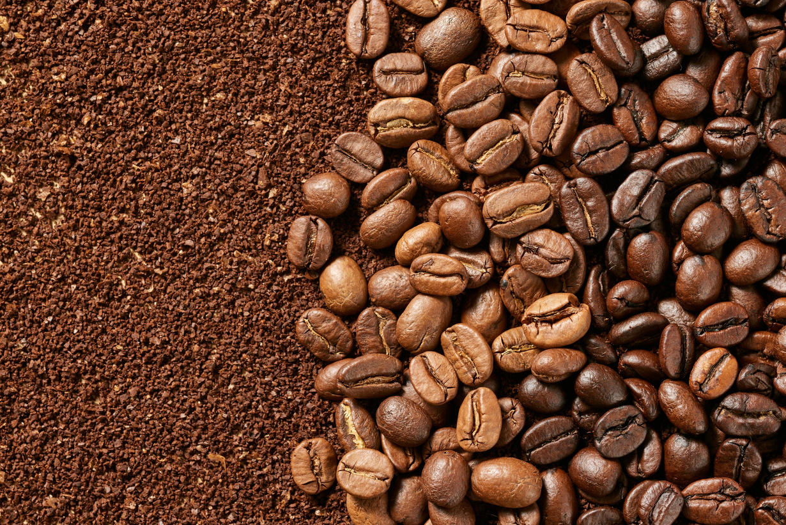
Bright Coffee Shop
TABLE OF CONTENTS
  Overview
  Performance deep dive
  Key findings
  Recommendations
  Q & A

Slide 3

Bright Coffee Shop
OVERVIEW
Product categories:
  Bakery
  Branded
  Coffee
  Coffee beans
  Drinking Chocolate
  Flavours
  Loose tea
  Packaged Chocolate
  Tea
The Total revenue stands at R698 812.33 with a declining trend requiring immediate attention. We have nine product categories in each store, and only two are performing well.
Stores:
ASTORIA.
HELL’S KITCHEN.
LOWER MANHATTAN.

Slide 4
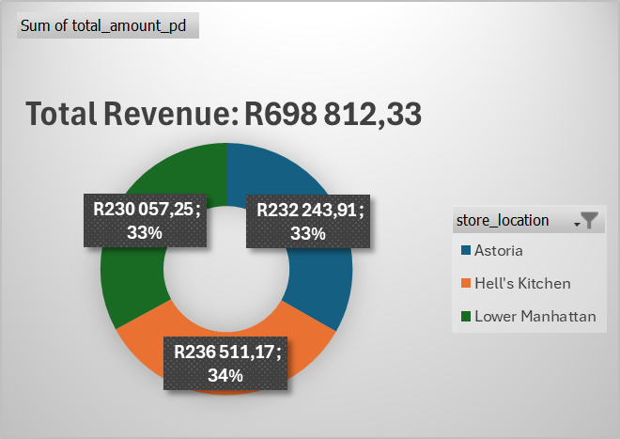
Bright Coffee Shop
PERFORMANCE DEEP DIVE
Hell’s Kitchen slightly outperforms the other locations, contributing 33.84% of total revenue, followed closely by Astoria and Lower Manhattan at 33.23% and 32.92% respectively. However, the differences are minimal(less than 1%), indicating balanced performance across all stores.

Slide 5
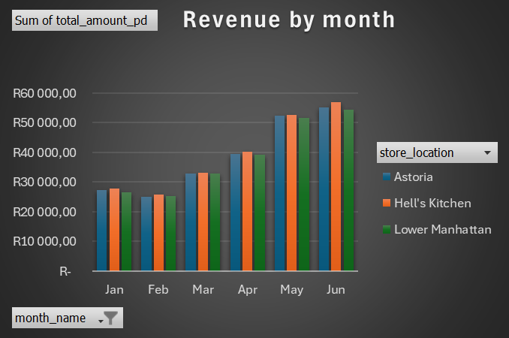
Bright Coffee Shop
PERFORMANCE DEEP DIVE
Revenue starts at a relatively stable level, then decreases in March. From March to June, it consistently increases across all locations. This suggests possibly seasonal demand building up over time. Hell’s Kitchen generates the highest revenue among the three stores, with Astoria following, and Lower Manhattan is behind but still follows the same trend. The gap between the stores is small; Hell’s Kitchen has a slight competitive edge in later months.

Slide 6

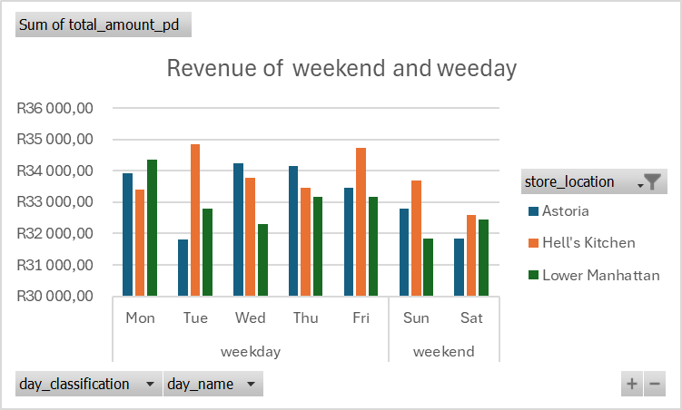
Bright Coffee Shop
Key findings
The business is clearly weekday-driven, with consistently higher revenue during the week, likely due to regular customer routines such as work and commuting patterns. Revenue declines slightly over the weekend, suggesting reduced customer activity. Tuesdays and Fridays emerge as the strongest revenue days, indicating peak demand periods.

Slide 7
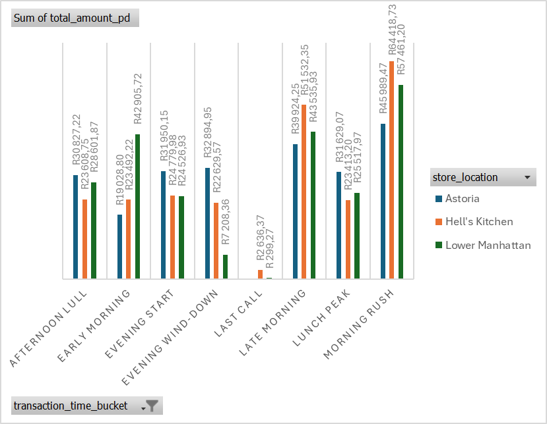
Bright Coffee Shop

Slide 8
Bright Coffee Shop
The last slide shows a clear customer pattern. The morning period dominates overall revenue. Morning rush is the highest revenue-generating period across all locations. Late morning and lunch peak also perform strongly, maintaining high sales momentum. Afternoon null indicates reduced customer activity. Evening wind-down and last call generate the lowest revenue, especially last call. Lower Manhattan leads during Morning rush and late morning, Hells kitchen perfoms well across most slots, and Astoria is consistent but slightly lower compared to the other two locations.
Early morning (6-8 am)
Morning Rush (8-10 am)
Late Morning (10-12 am)
Lunch Peak (12-2 pm)
Afternoon Lull (2-4 pm)
Evening start (4-6 pm)
Evening Wind-down (6-8pm)
Last call(8-10pm)

Slide 9
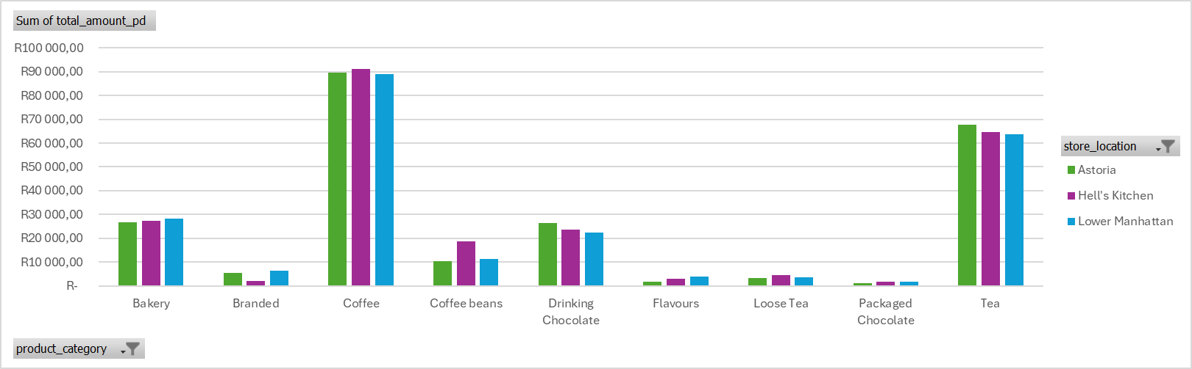
Bright Coffee Shop
Coffee is the dominant category across all three locations, and Tea is the second-best-performing category. However, Coffe beans are underperforming. This indicates that customers are buying coffee to consume in-store rather than purchasing beans for home brewing. Bakery and Branded are average-performing. Branded, Flavours, Loose tea, and Packaged Chocolate are low-performing.

Slide 10
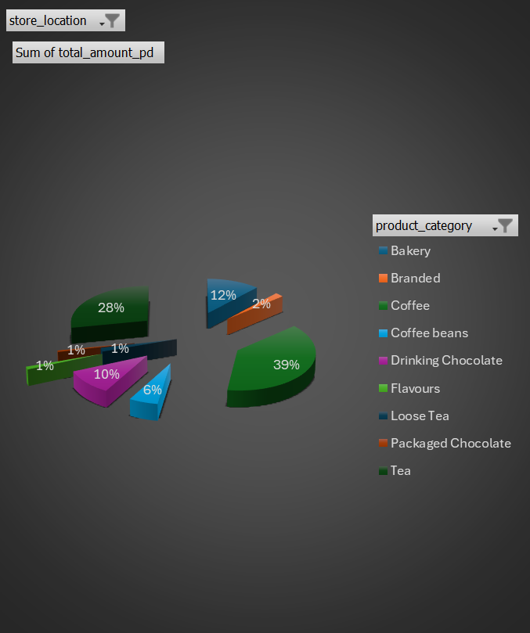
Bright Coffee Shop
Coffee and Tea combined contributes 67% to the revenue; they are the backbone of the business. Bakery and Drinking Chocolate - 22%. Coffee beans-6%. Others combined-5%.
  Focus inventory and marketing on the two high-performing categories and two secondary-performing categories. Promote the secondary performing categories by creating combo deals.
  We can phase out the five weakest categories and use the space to grow coffee bean sales; it has growth potential.
  Hell’s Kitchen outperforms Astoria and Lower Manhattan in every category, so we can replicate the store’s success.
Recommendations

Slide 11
Bright Coffee Shop
Launch an afternoon happy hour during the afternoon lull hours. It captures less of the daily revenue compared to the morning peak hours. Boost weekend sales with special promotions and improve weekday service speed. Expand the menu with cold beverages, indulgent treats, and child-friendly items to attract new customer segments and boost performance during low months.
Turn holidays into revenue opportunities. Host special events and limited-time offerings for major holidays. If the low performing categories are not phased out,, we can launch a birthday rewards program offering special discounts and free items to customers on their birthdays, such as branded items.
Implement a social media strategy across Instagram, Facebook, and TikTok. Build a loyal following and offer exclusive percentage-off discounts to followers to drive traffic during slow periods. Create simple, fun, and visually engaging activities at your coffee shop that content creators will want to film and share with their followers.
Launch a loyalty card program where customers earn points or stamps with every purchase, redeemable for free items after a certain number of visits. Launch delivery and takeaway services through delivery platforms partnerships and takeaway-focused promotions, with special emphasis on last call hours.

Slide 12






Bright Coffee Shop
  LASTLY, REFRESH THE SHOP SETTING EVERY 4 MONTHS WITH SMALL, LOW-COST CHANGES TO KEEP THE ENVIRONMENT FEELING NEW AND EXCITING.
THANK YOU

Slide 13



Bright Coffee Shop
Q & A?

